Slide 1

Scarcity and the factors of production
1.1.1 The economic problem

Slide 2
1.1.1 The economic problem - What we learn
The problem of scarcity – where there are unlimited wants and finite resources, leading to the need to make choices.
Opportunity cost and its effect on economic agents (consumers, producers and government).
The use of diagrams to show production possibility curve.
Production possibility curve diagram should be used to show:
the maximum productive potential of an economy
fully employed or unemployed resources
opportunity cost
positive or negative economic growth that shifts the production possibility frontier (PPF) outwards and inwards
possible and unobtainable production.
Possible causes of positive or negative economic growth.

Slide 3
Key terms for this lesson
resources
finite
infinite
needs
wants
basic economic problem
Scarcity

Slide 4
What would you buy - a good or a service?
My dog is ill - I don’t know what is wrong
My tooth is aching
My hair is too long.
I have grown out of my shoes
It’s my best friend’s birthday
I am thirsty
Notes:
Get students to discuss goods or services

Slide 5
Goods and services
Goods are tangible items you buy. Examples?
Services are ‘actions’. Examples?

Slide 6
Types of goods
Consumer goods - purchased by households such as food, cards, ipods, furniture etc.
Capital goods - purchased by firms to produce other goods such as machinery, tools, equipment.

Slide 7
Wants & needs
Consumers needs (essential to living) and wants are fulfilled buying goods or services.
Wants are infinite - people always want more.
Resources are finite - there is not enough.
Infinite
Finite
vs

Slide 8
The economic problem
Limited
Scarce resources
Unlimited wants and needs
Production
The economic problem is to match limited resources to unlimited wants and needs

Slide 9
3 fundamental questions
What to produce?
For whom?
How to produce?
Fundamental question about economics

Slide 10
Factors of Production
Are resources
These are the building blocks of an economy
They are used for production (output)

Slide 11


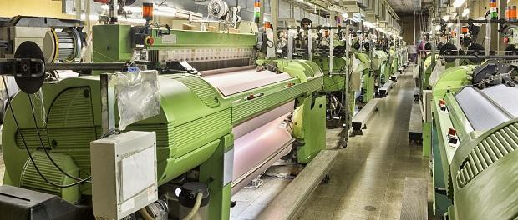

Finite resources - factors of production
Land
Labour
Capital
Enterprise
Notes:
All these are used to produce goods and services

Slide 12
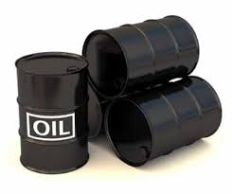

Land
Covers land itself and all natural resources within land and water
e.g. oil, trees, livestock, fish, etc

Slide 13
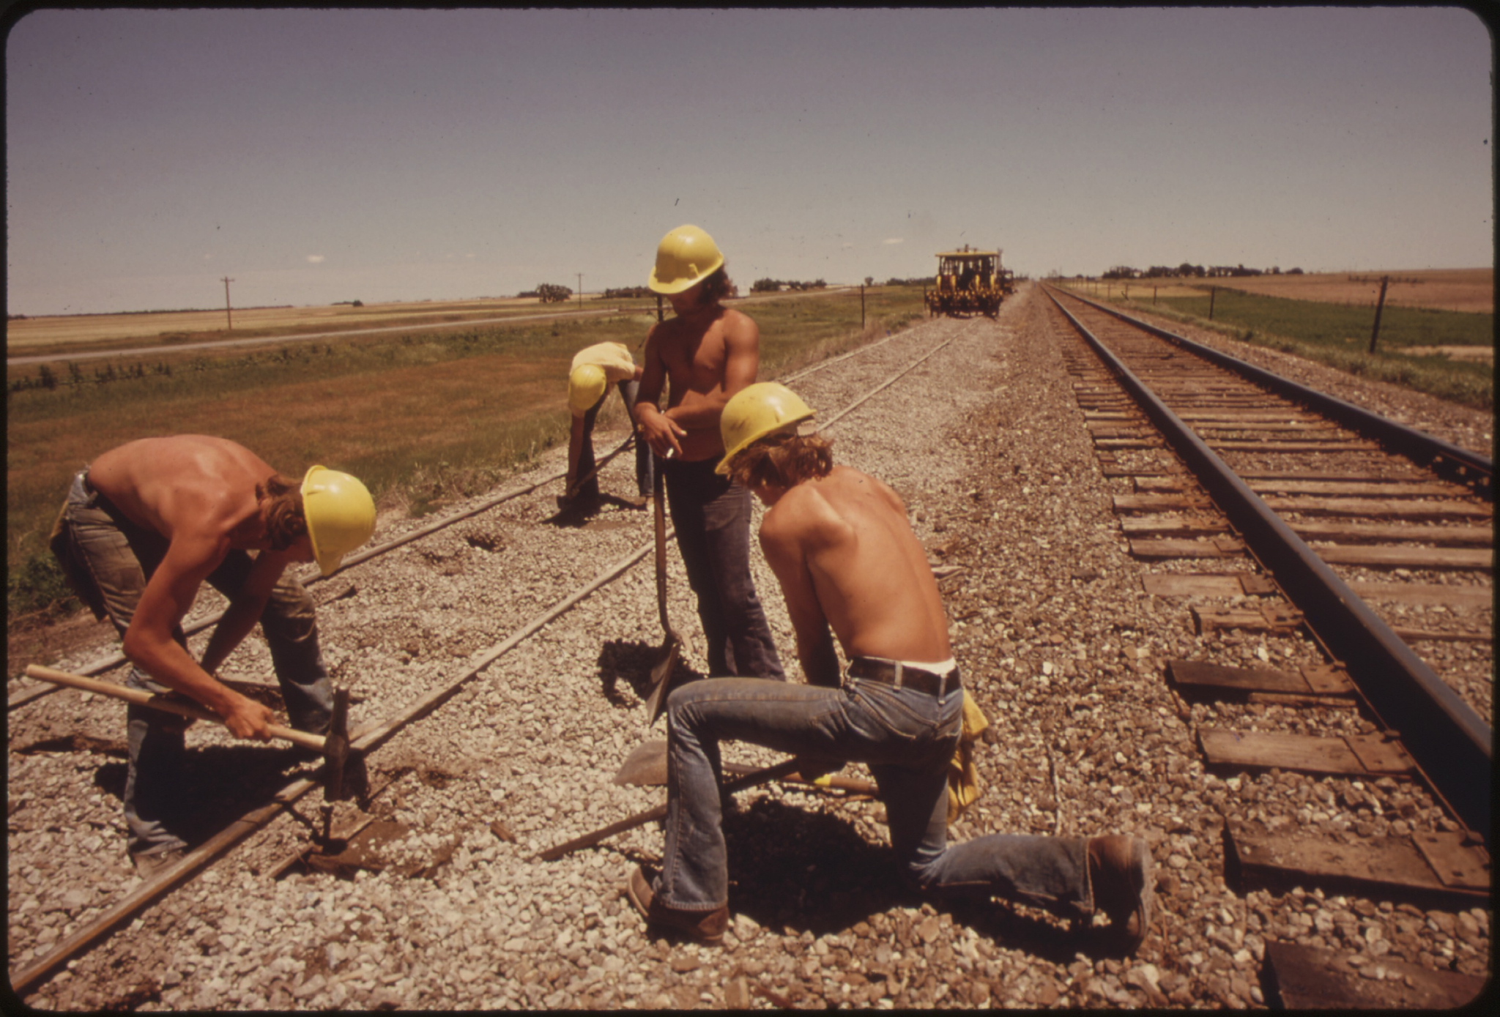
Labour
The number of people available to work.

Slide 14

Capital
The finance and machinery and equipment needed to manufacture products/provide a service

Slide 15

Enterprise
The skills and risk-taking ability of the person who brings the other resources or factors of production together to produce a good/service
i.e. business owner/entrepreneur
Notes:
Worksheet https://docs.google.com/document/d/1RXtRIO1Ob4787rgMLPAWhyVA7mCCHl1mhyn4kM9Q4pI/edit

Slide 16

Discuss
In small groups:
Identify the factors of production used at Island School
Notes:
Land - land where school is being built - huge scarcity in HK.
Labour - teachers, cleaners, security guard
Capital - desks, laptops, buildings, DT tools/workshop
Enterprise - management, leadership

Slide 17
The economy
Producers - firms that makes goods/ services
Government
Collect tax
Spending on public services/goods
Regulations
Consumers - individuals/households who purchase goods/services

